Slide 1

PROJECT NAME: BANKRUPTCY PREVENTION
Team Name :Group-1
Mentor Name :Munmun Bhagat
Start Date :11/04/2022

Slide 2
Business Problem:
To create a Classification model which can predict whether company will go bankrupt or not based on given features and make strategies accordingly to avoid its bankruptcy
Objective:
To predict bankruptcy or non-bankruptcy with the help of model which gives probability that a business goes bankrupt from different features.

Slide 3
Project Architecture / Project Flow
EDA & Feature Engineering
Model Building
Model Results
Model Evaluation
Deployment

Slide 4
Exploratory Data Analysis (EDA) and
Feature Engineering

Slide 5
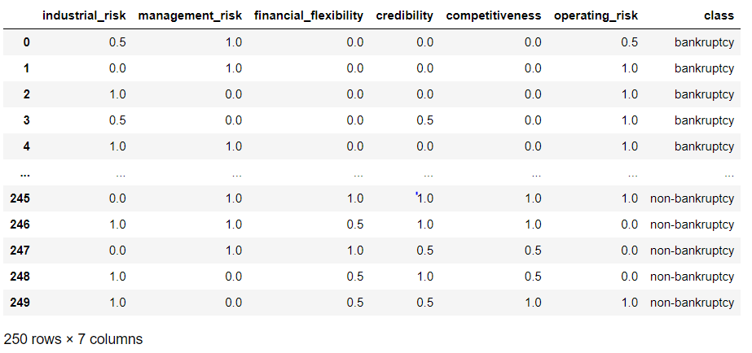
Data set details
Data contains 250 rows and 7 columns
Total features are six and one target variable
No Missing values

Slide 6
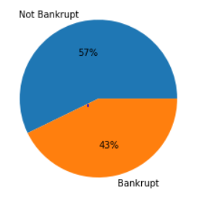
Exploratory Data Analysis (EDA)
Work Flow for the EDA
Checking Duplicate values
1
Renaming columns
2
Label Encoding
3
Target Variable(Class)
Data is balanced
Checking for Unnecessary column
4
Checking for outliers
5
147 rows found duplicated, as it can contain important information it is not deleted
Checking for missing values
6
Correlation between features and target variable
7
Feature scaling
8

Slide 7
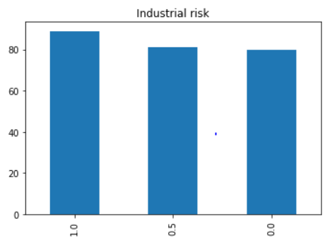
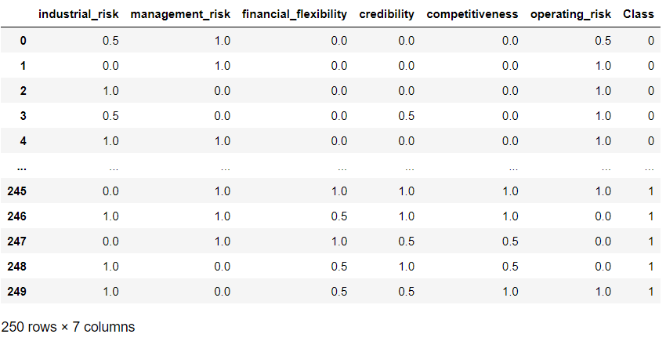
Data After EDA
Results of EDA:
Columns are renamed to remove spaces
Label encoding done for target variable ‘Class’
No unnecessary column found
No outlier found in any feature
No missing values
Bar chart for detection of outlier
Data after EDA

Slide 8
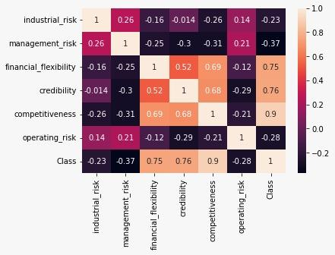
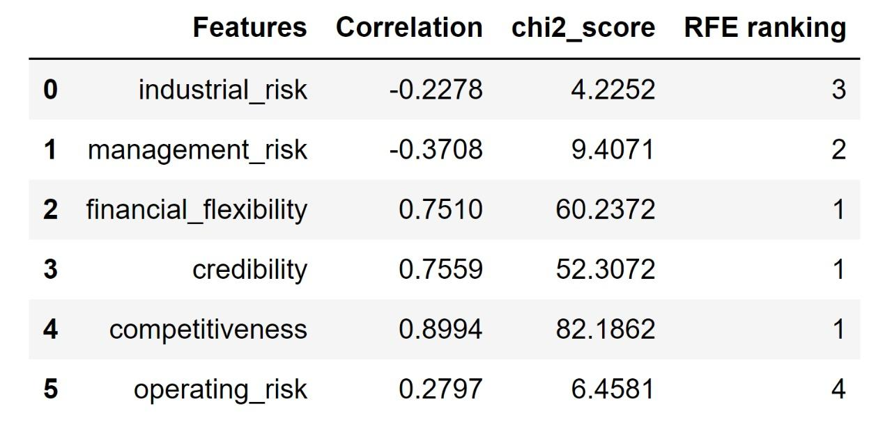
Feature Engineering
Correlation
Standardization
Chi square feature selection
RFE feature selection
Correlation
Features Descriptive Information
Three features will be selected in model which are:
Financial flexibility
Credibility
Competitiveness
All features contains values of 0,0.5 and 1 so data is balanced and standardized so no standardization is required

Slide 9
Model Validation
1)Evaluating using Train Test Split
Result- 100.00
2)Evaluating using Cross Validation (K-Fold)
Result- 99.2

Slide 10
Model Building
The models we built are :
1. Logistic Regression
2. Decision Tree
3. Naive Bayes
4. KNN
5. SVC
6. AdaBoost
7. Bagged Decision Tree
8. Random Forest
9. Voting Classifier

Slide 11
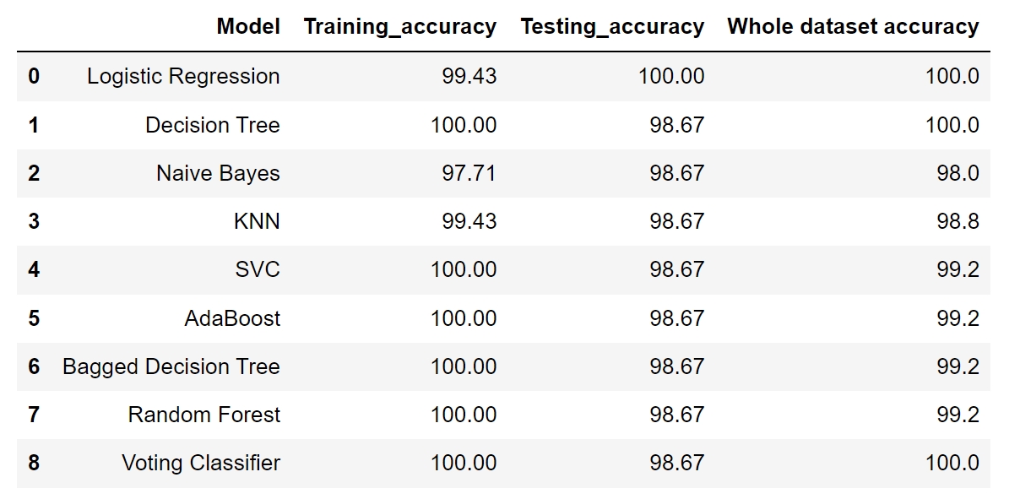
Model accuracy comparison

Slide 12
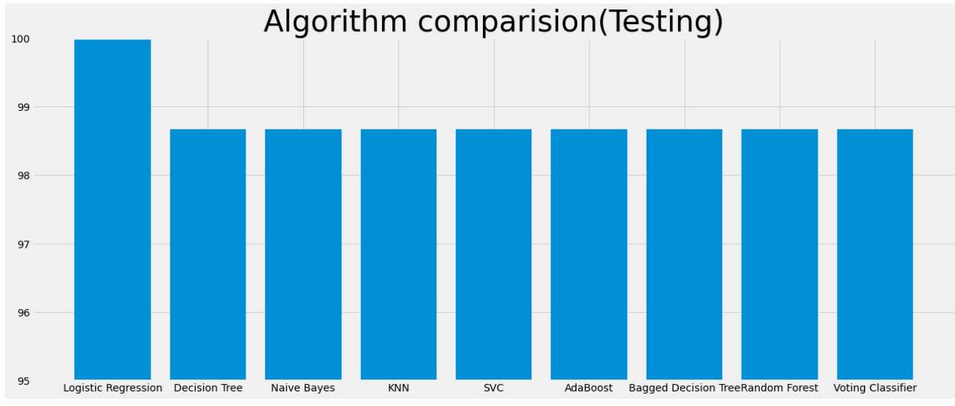
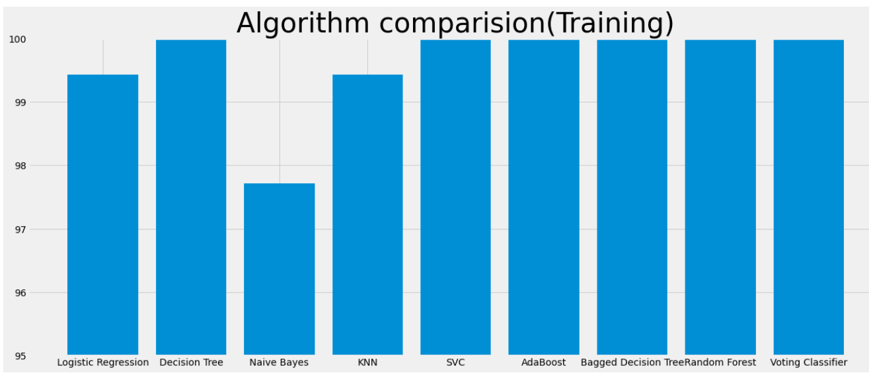
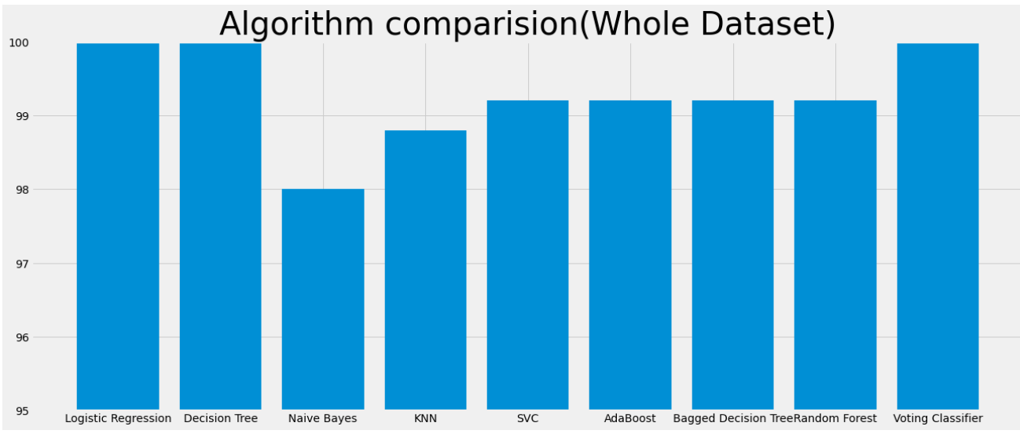
Visualizing model accuracies
Testing accuracy
Training accuracy
Whole dataset accuracy

Slide 13
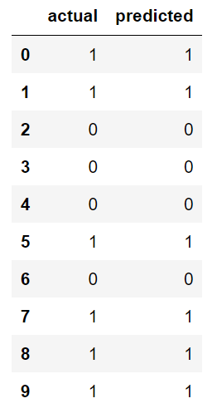
Model Predictions with given data
The chart shows the prediction for the ten records

Slide 14
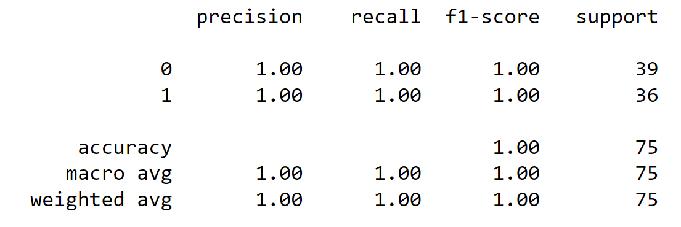
Final model(Logistic Regression)
The Logistic Regression model has perfectly classified everything as it is evident in the classification report.

Slide 15
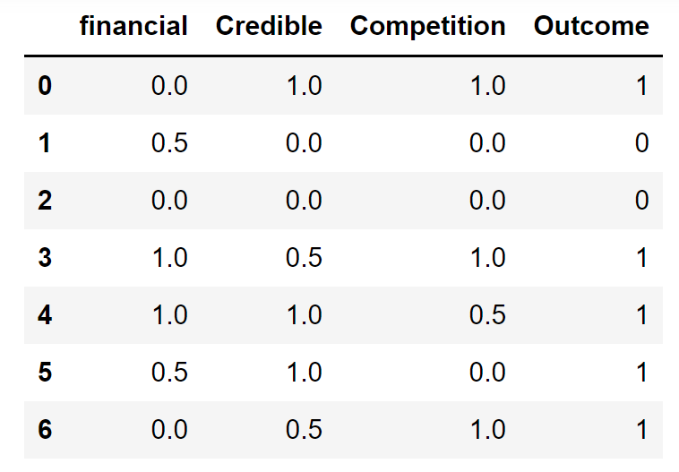
Model Predictions with new data

Slide 16
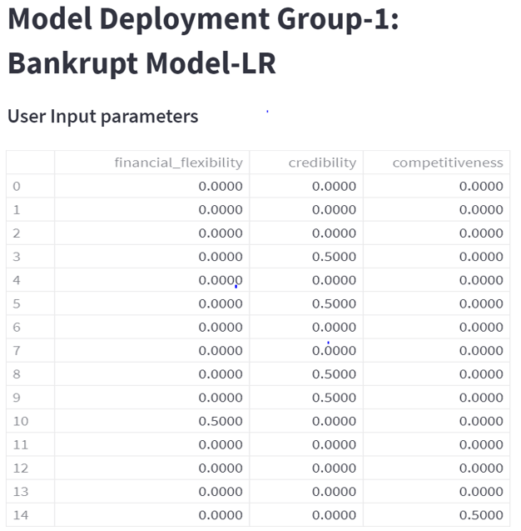
Model Deployment
Model Deployment: Bankrupt Model-LR

Slide 17
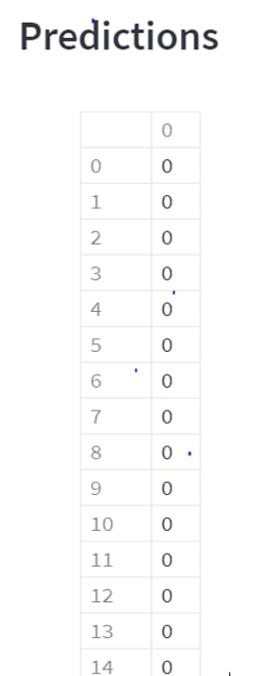
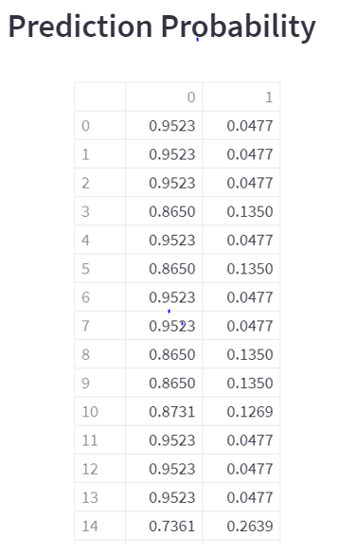
Model Deployment
Model Deployment: Bankrupt Model-LR
0 – Bankruptcy
1 – Non Bankruptcy

Slide 18
Challenges faced?
How did you overcome?
1)Converting target variable into categorical variable.
label encoding
2)Removing unnecessary columns.
feature engineering .
3)Choosing the best classifier.
compare the accuracies of the all the model.

Slide 19
Thank you

